Slide 1

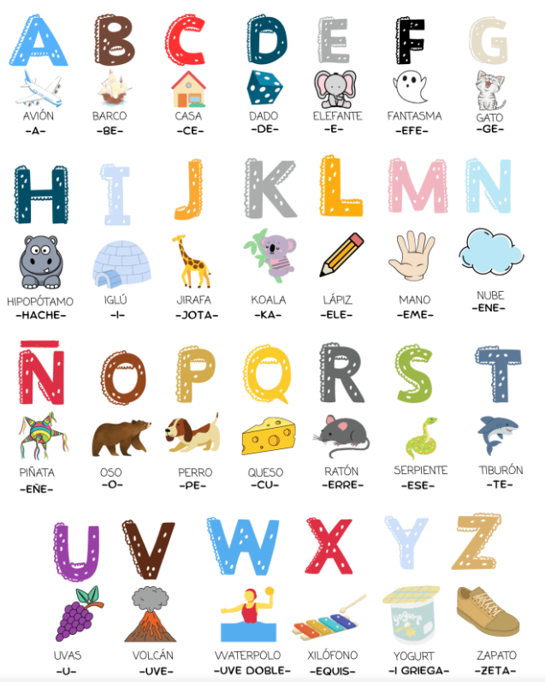



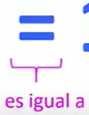

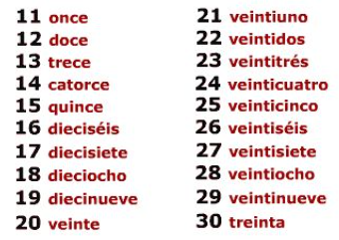
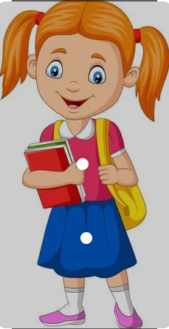
Spanish - Unit 11 Numbers 11 to 30
& Alphabet
Year 4
Autumn 2
Golden Thread: Belonging
Working together to be the best that we can be
¿Como se escribe?
Did you know that there are 27 letters in the Spanish alphabet! Can you find the extra letter.
Maria

