Slide 1

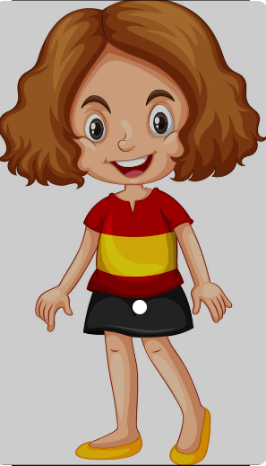
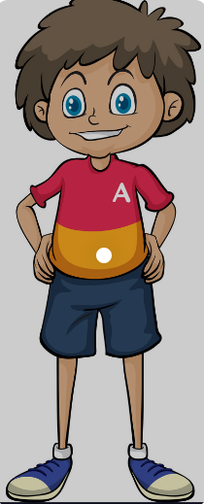
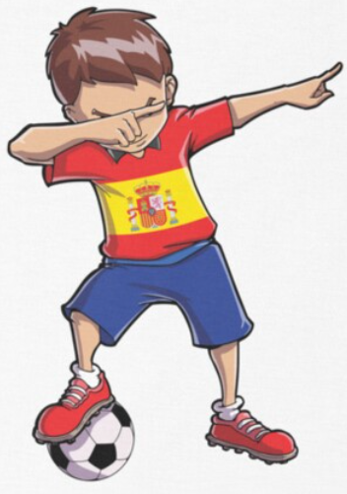
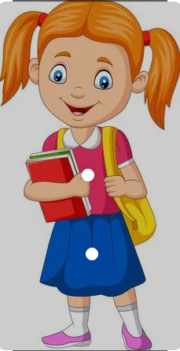
Spanish - Unit 3 Body Parts & Easter
Year 3
Spring 1
Golden Thread: Belonging
Working together to be the best that we can be
la cabeza
Did you know that Spanish nouns can be sorted in to girl and boy words!
los ojos
las oregas
la nariz
Isabella
los hombros
The Gender of Spanish Nouns
Masculine (Boy words) | Feminine (Girl words)
Words ending in – o | Words ending in – a
The = El (s) The = Los (pl) A = Un (s) | The = La (s) The = Las (pl) A = Una (s)
la boca
Los ojos.
La cabeza.
Graphemes
a, e, i, o, u, ll, j, z, cu, ci, ñ, ca, h.
las rodillas
Manuel
Maria
Juan
los pies

