Slide 1

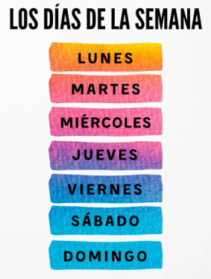
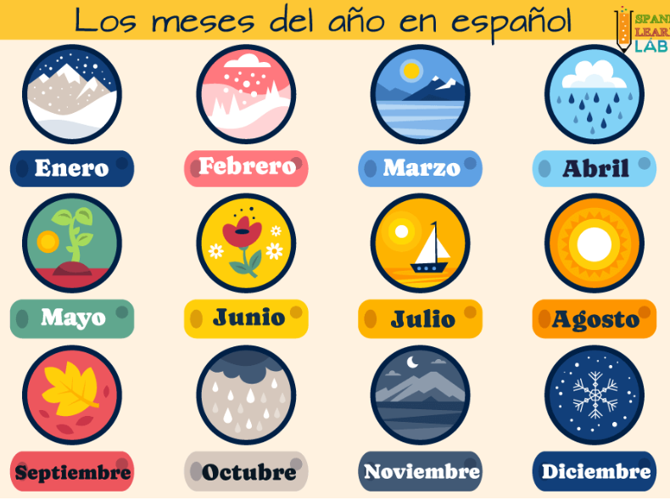
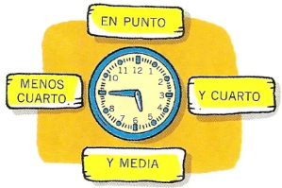
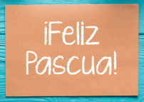
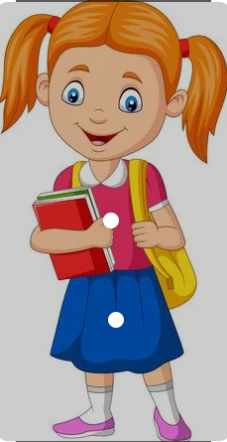
Spanish - Unit 13 Time
Year 4
Spring 2
Golden Thread: Civilisations
Working together to be the best that we can be
¿Qué hora es?
Can you remember what happens in Spain during Easter celebrations?
Ayer – yesterday
Manaña - tomorrow
Los huevos de Pascua – Easter eggs
Los panecillos de Pascua – hot cross buns
Pasos – Easter floats in the parade

