Slide 1

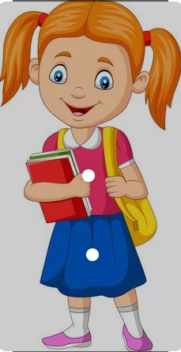
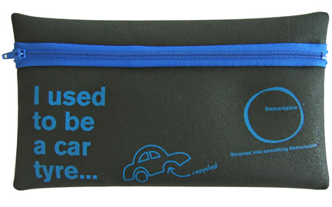
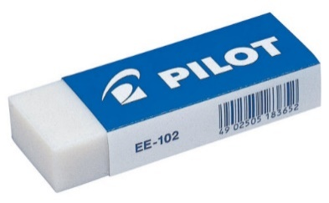
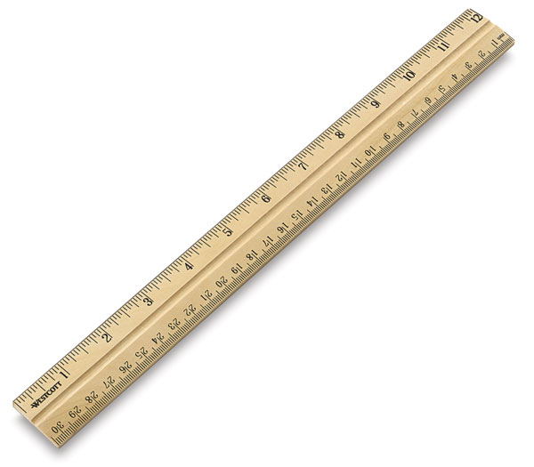
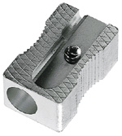


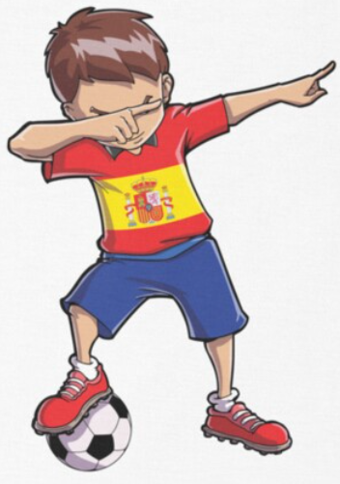
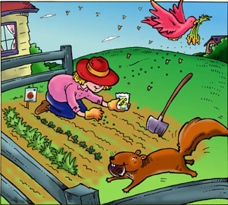
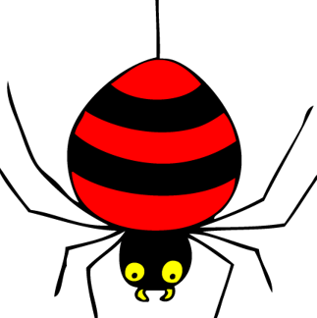
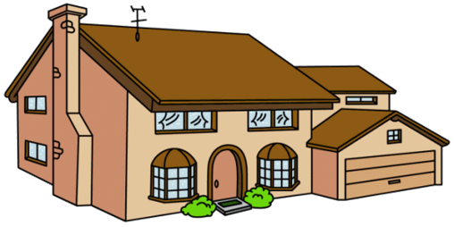

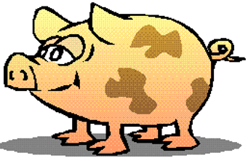
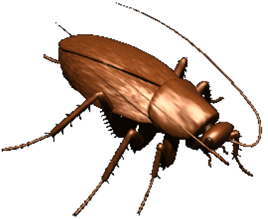






Spanish - Unit 8 In My Pencil Case
Year 3
Summer 1
Golden Thread: Belonging
Working together to be the best that we can be
Una goma
Un lápiz
Do you know the word, letter sound and action for each of these images?
Un estuche
Un sacapuntas
Un bolígrafo
15
Una regla
Verbs
Tengo – I have
Tienes – You have
Tiene – He/She/It has
Quiero – I want
Quieres – You want
Quiere – He/She/It wants
En mi estuche tengo…

