Slide 1


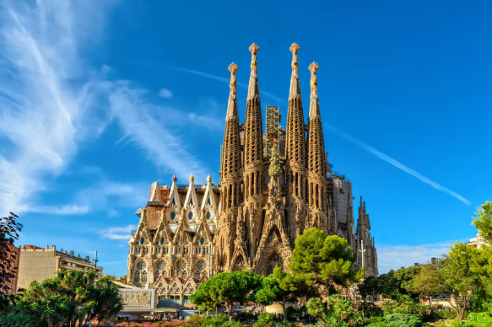
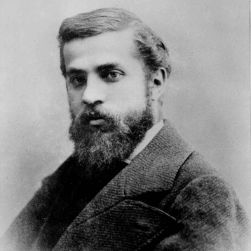
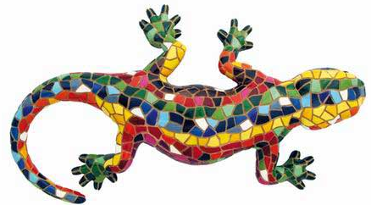
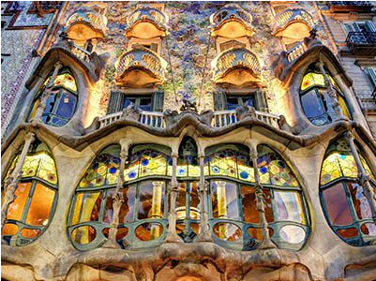
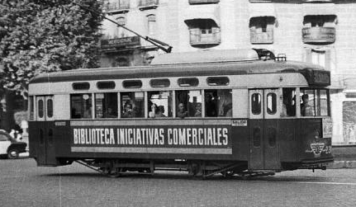
Spanish - Unit 9 Antoni Gaudí
Year 3
Summer 2
Golden Thread: Material Culture
Working together to be the best that we can be
Did you know the
Sagrada Familia, designed by Gaudi, was started in 1882 but still isn’t finished!
Glossary
Architect - somebody who designs and is in charge of making buildings.
Trencadís - a type of mosaic made from cemented-together tile shards and broken chinaware.
Casa Batllo
Antoni Gaudí
Born 25th June 1852 in Reus, Spain.
Died 10th June 1926 in Barcelona.
What has a tram got to do with Antoni Gaudí?

