Slide 1

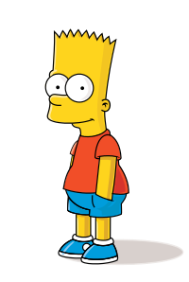
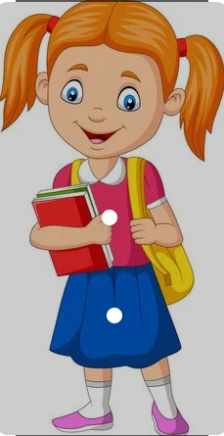
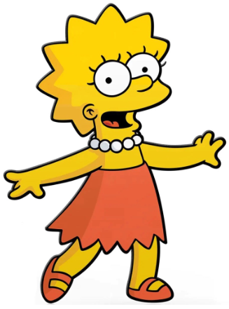
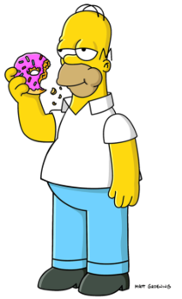
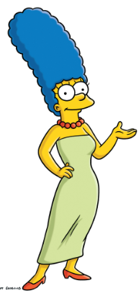
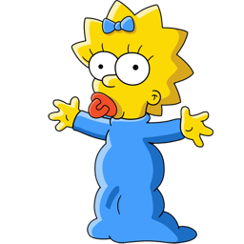
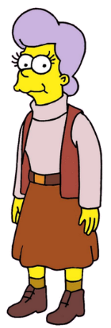
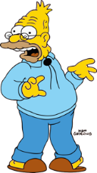
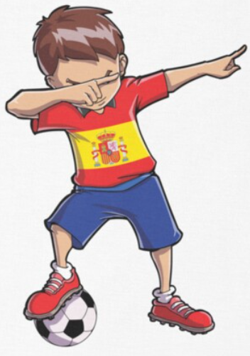
Spanish - Unit 10 My Family
Year 4
Autumn 1
Golden Thread: Belonging
Working together to be the best that we can be
Here are some useful words to help you describe personalities.
Mi hermana, se llama Lisa.
Mi hermano, se llama Bart.
Maria
Ambitious – ambicioso
Annoying – molesto
Anxious – ansioso
Loving – amoroso
Mean – grosero
Thoughtful – considerado
¡Hola! Me llamo Maggie, aqui es mi familia…
Mi padre, se llama Homer.
Remember to change the word endings to masculine or feminine depending on who you are talking about.
Manuel
Mi madre, se llama Marge.
Mi abuela, se llama Mona.
Mi abuelo, se llama Abe.

